Slide 1

2026 Local Government Extraordinary Elections
Notes:
Hello
My name is Phil Richards Manager, Election Events & this presentation will cover aspects of the election process including:
Eligibility to be a candidate
The Nomination process
Postal Voting (both for postal & in-person elections)
Voting
Election Day & Election Night (count)

Slide 2
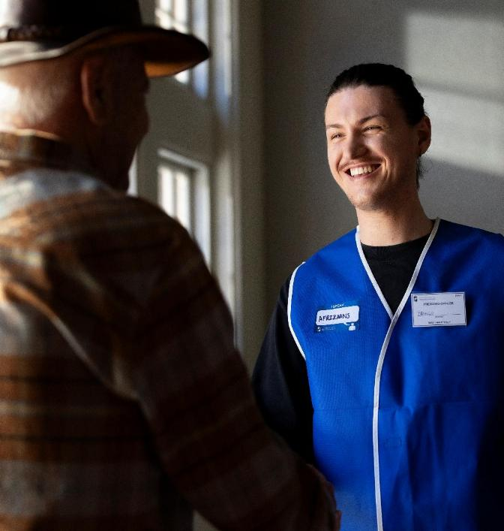
WAEC Key Contact
Returning Officer
  One per local government
  Conducts election on behalf of WAEC or local government
  First point of contact with questions or complaints
Notes:
If the WA Electoral Commission is conducting the election, the Electoral Commissioner appoints the Returning Officer.
If the election is being run by the local government, the Chief Executive Officer serves as the Returning Officer.
The Returning Officer is the authorised official responsible for conducting the election and will be your primary point of contact if you nominate as a candidate.
Your Returning officer will:
take your nomination
Answer your questions
Try to resolve simple complaints
Supervise the count
Decide if ballot papers are formal or informal
Authorise a recount
Declare the result
Please make use of them – they are there to help you but also to make sure the election is conducted within the guidelines of the legislation.

Slide 3
Nominations
Are you eligible to nominate for council/mayor or president
To stand for election as a councillor, or a mayor or president elected by the people of a local government district, you must, at both the close of enrolments and the time of nomination:
be 18 years of age or older
be an elector of the district
not be a member of State or Federal Parliament
not be bankrupt or a person whose affairs are under insolvency laws
not be serving a prison sentence for a crime
not have been convicted of a serious local government offence within the last 5 years (unless the court has waived the disqualification)
Notes:
Close of Enrolment is defined at s4.39 – 5pm on 57th day before election day

Slide 4
Nominations
Are you eligible to nominate for council/mayor or president – Part 2
not have been convicted of an offence for which the indictable penalty was or included imprisonment for life, or imprisonment for more than 5 years
not be a member of another council
not be subject to a court order disqualifying you from being a council member because you have misapplied local government funds or property
not be on the local electoral roll as the nominee of a body corporate (unless you would also be eligible for enrolment on other grounds)
not be currently disqualified by the State Administrative Tribunal from holding office.
You must also, at the time of nomination, have completed the mandatory Local Government Candidate Induction available on the Department's website.

Slide 5
Eligible to be an elector
To be an eligible elector you must, at both close of enrolments and the time of nomination:
be enrolled as an elector of the district at the close of enrolments or
have made a successful eligibility claim with the Local Government

Slide 6

An effective nomination
Completed form
Completed and signed nomination form (including reference number & date of completion of the on-line candidate induction)
Candidate profile
Completed Candidate profile
Cash deposit
  Deposit $100 cash. Must be received by local government before the close of nominations
Written statement
  Additional written statement containing information that the candidate considers relevant to their candidature (optional)
Nomination received
  Received by the Returning Officer before the close of nominations
Notes:
To ensure your nomination is valid, you must complete the Local Government Candidate Induction Course available on the Department of Local Government, Industry Regulations and Safety website, and provide a copy of the acknowledgement email showing your reference number and completion date.
You must also submit your completed nomination form, including the induction course details, a candidate profile, and a $100 deposit. This deposit can be paid via cash, money order, bank cheque, credit card, or bank transfer, including EFT—provided it is received by the local government before nominations close.
You may also include any additional information you consider relevant to your candidacy.
All required materials must be received by the Returning Officer before the close of nominations.

Slide 7
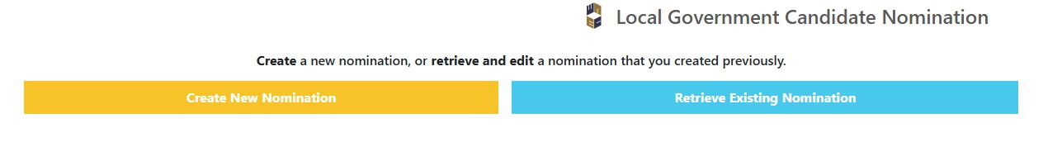
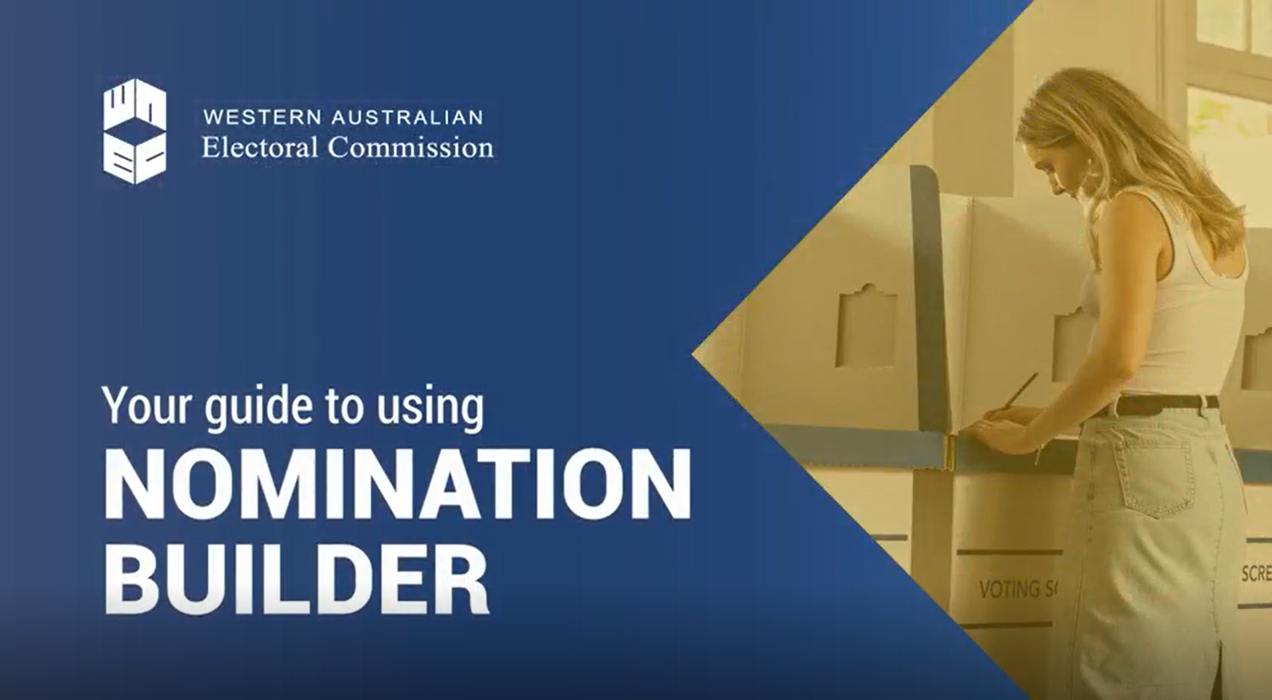
Online WAEC Nomination Builder
  Online nomination builder available from elections.wa.gov.au
  You can prepare the nomination form, profile and upload photograph online
  Provide nomination ID at Returning Officer interview when submitting nomination
!
Important Note
You cannot nominate online
Notes:
Candidates can use the online platform Nomination Builder, available on the WA Electoral Commission website, to prepare and submit their nomination profile.
This tool allows candidates to enter their profile details, upload a photo, and include any additional information, ensuring accuracy for printing.
Upon using Nomination Builder, candidates will receive a Nomination ID, which must be provided to the Returning Officer when lodging their nomination.
A printed copy of the candidate profile must also be presented during this meeting.

Slide 8

Candidate Profile
  Sent out with postal voting packages and posted on council website
  Written in English – limit of 1,000 characters including spaces
  Passport size recent photograph, head or head and shoulders (optional)
  Is to Contain:
    Biographical information about the candidate
    Statement of candidate’s policies or beliefs
  Cannot contain:
    information that the RO considers to be false, misleading or defamatory
CANDIDATE PROFILE
Notes:
When using Nomination Builder, your candidate profile must be written in English and must not exceed 1,000 characters, including spaces.
It should include biographical details, a statement outlining your policies or beliefs, and at least one personal contact detail—such as an email address, phone number, or physical address.
You also have the option to upload a passport-sized photograph taken within the last six months.

Slide 9
Additional Information
  Also consider:
  Additional Information is optional
  Is to be written in English
  A limit of 2,000 characters including spaces
  Should accompany the candidate’s nomination paper
  Is not to contain any information that the Returning Officer considers false, misleading or defamatory
  Can use Nomination Builder to prepare the additional information
  Will be published on the Council website only
CANDIDATE PROFILE
Notes:
Through Nomination builder you have the option to include additional relevant information as part of your profile
This information is what you as a candidate would consider relevant to your candidature.
This additional information must:
be in the English language
Be no more than 2,000 characters including spaces
The information provided must not contain any information that the Returning Officer considers to be false, misleading or defamatory
This information will only be published on the relevant local government official website, not included in election packages

Slide 10

Electoral Rolls
  Free to candidates for campaigning purposes
  1 Residents Roll and 1 Owners and Occupiers Roll
  (for the ward or district they are contesting)
  A statutory declaration needs to be completed regarding the destruction and deletion of copies of rolls
  Offences for misuse of roll
Notes:
Candidates are to receive one copy of the electoral roll for the ward or district they are contesting. This includes both the Residents’ Roll and the Owners’ and Occupiers’ Roll. Members are entitled to receive a copy of the electoral roll free of charge upon request.
Mayoral candidates are entitled to the roll for the entire district.
If a candidate receives a copy of the roll, they must submit a statutory declaration to either the Electoral Commissioner or the local government CEO confirming that all copies have been destroyed or permanently deleted from any device, computer, or storage system by the end of the relevant period.

Slide 11
Electoral Rolls
The relevant period is determined by | The Statutory declaration must | Penalty
Candidate not elected – 5 working days after result of election is declared | Identify the election | A fine of $5,000
Candidate elected – 5 working days after the term of office ends or the office becomes vacant | Include a description of every supplied copy | A daily penalty of a fine of $50 for each day or part of during which the offence continues
Member of Council (who is not a candidate) – the term of the members current office ends or the office becomes vacant | Including whether the supplied copy was in electronic form
 | In relation to every supplied copy - the steps described taken to destroy it or to delete it permanently
Notes:
The relevant period for declaring the destruction or deletion of electoral roll copies depends on the candidate’s status.
For candidates who are not elected, the declaration must be made within five working days after the election result is declared.
For elected candidates, it must be made within five working days after their term of office ends or the office becomes vacant.
For council members who were not candidates, the declaration is due when their current term ends or the office becomes vacant.
The statutory declaration must identify the election, describe each copy received including whether it was in electronic form and detail the steps taken to destroy or permanently delete each copy. Failure to comply may result in a fine of $5,000 and a daily penalty of $50 for each day the offence continues.

Slide 12
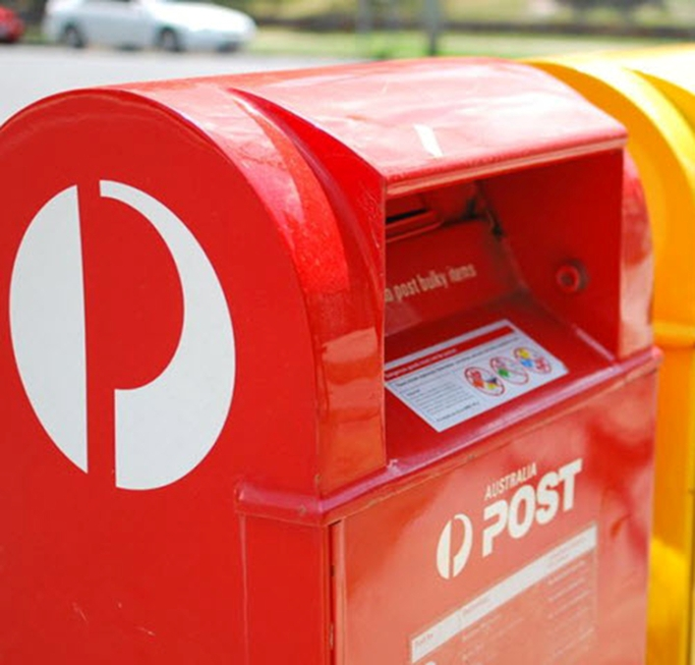
Postal voting
Mail out of packages
  Lodged by WAEC with Australia Post from Friday 24 February 2026
!
Important Note
Maximise campaigning around the delivery of the election packages
Notes:
Postal Voting packages are lodged with Australia post on different dates for regional and metropolitan local governments.
Election packages for Country Local Governments are lodged with Australia Post commencing on Friday 12 September 2025
Election packages for Metropolitan Local Governments are lodged with Australia Post commencing on Wednesday 17 September 2025
We encourage candidates to actively engage with voters during the delivery period of election packages as this can maximise the impact of their campaigns.

Slide 13
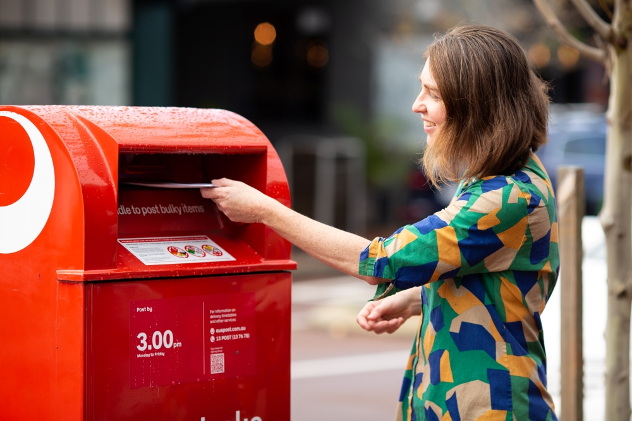
Postal voting
Return of voting packages
  Packages can be posted to the Returning Officer using the supplied reply paid envelope or hand-delivered to the local government office
  Numbers returned to WAEC posted on the Commission’s website daily
  Typically about 50% of returned packages are received within the first 5 business days of delivery
Notes:
For the return of Voting Packages, Packages can be posted to the Returning Officer using the supplied reply paid envelope or hand-delivered to the local government office.
You can find the daily updates of the number of returned postal packages received by Australia Post on the WAEC website.
Any completed packages returned to the WA electoral Commission are delivered to the Returning Officer.

Slide 14
Postal Voting
By Application
  Electors who have applied for a postal vote will be sent their election package as soon as practical around the publication of the Election Notice
  Returned Postal Votes can be posted to the Returning Officer using the supplied reply paid envelope or hand-delivered to the local government office
Notes:
Postal voting is also available for In Person Elections
Electors who have applied for a postal vote will be sent their election package as soon as practical around the publication of the Election Notice
Returned Postal Votes can be posted to the Returning Officer using the supplied reply paid envelope or hand-delivered to the local government office

Slide 15


Postal voting
Candidate Rules Replacement Packages
  Penalites can apply if:
  Local Government staff can issue replacement voting papers
  x
  You assist the elector to mark their ballot paper
  The original election package will need to be cancelled first by the local government or WA Electoral Commission.
  x
  You or a representative take custody of an envelope in which there is a postal vote
Notes:
There are rules that govern candidates in regards to postal voting
A Candidate or representative cannot assist the elector to mark their ballot
The Penalty for doing this is imprisonment for 12 months and a fine of $12,000
A Candidate or representative also cannot take custody of an envelope in which there is a postal vote.
The Penalty for doing this is imprisonment for 24 months and a fine of $24,000
For replacement packages, Local Government staff are responsible for issuing these and provisional voting papers from the day after the mail-out has occurred through to 18 October 2025
Any full or partial packages can be replaced
Provisional voting papers may be issued to a person who claims to have been omitted from the electoral roll in error (proof of omission required)

Slide 16
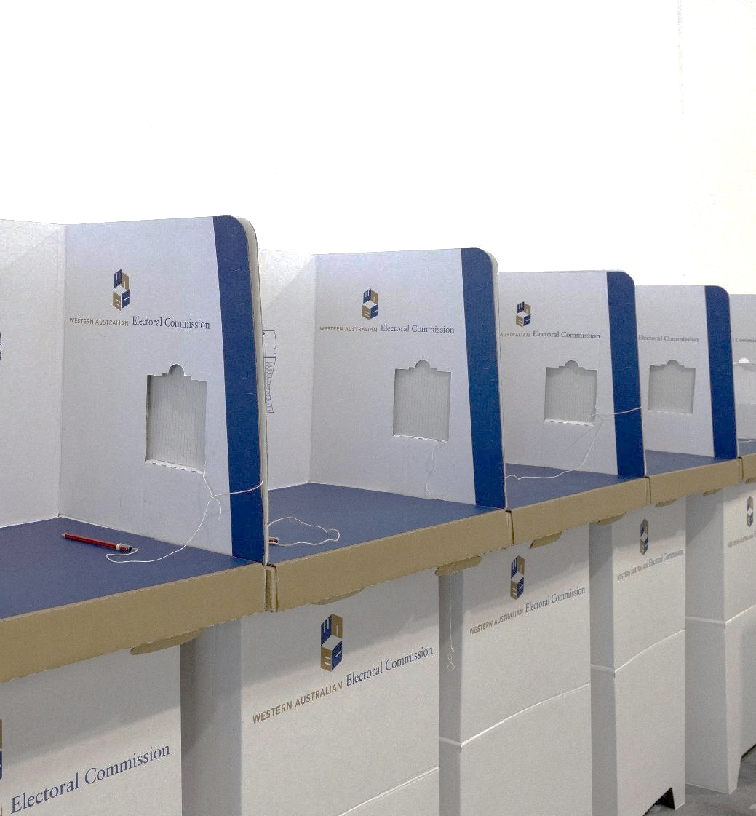
Election Day
Polling places
Can lodge their completed postal vote package at the Local Government; and
Can apply for a replacement vote package at any of the locations nominated by the Local Government on election Day
Notes:
On Election Day for in person elections, electors can cast an ordinary vote at any polling place.
On election day for postal elections, electors can drop off their completed postal vote at any polling place.
Local Government are required to provide at least one polling place in the District to be open between 8:00am & 6:00pm
Please note that opening times for other polling places within the district may be different.

Slide 17
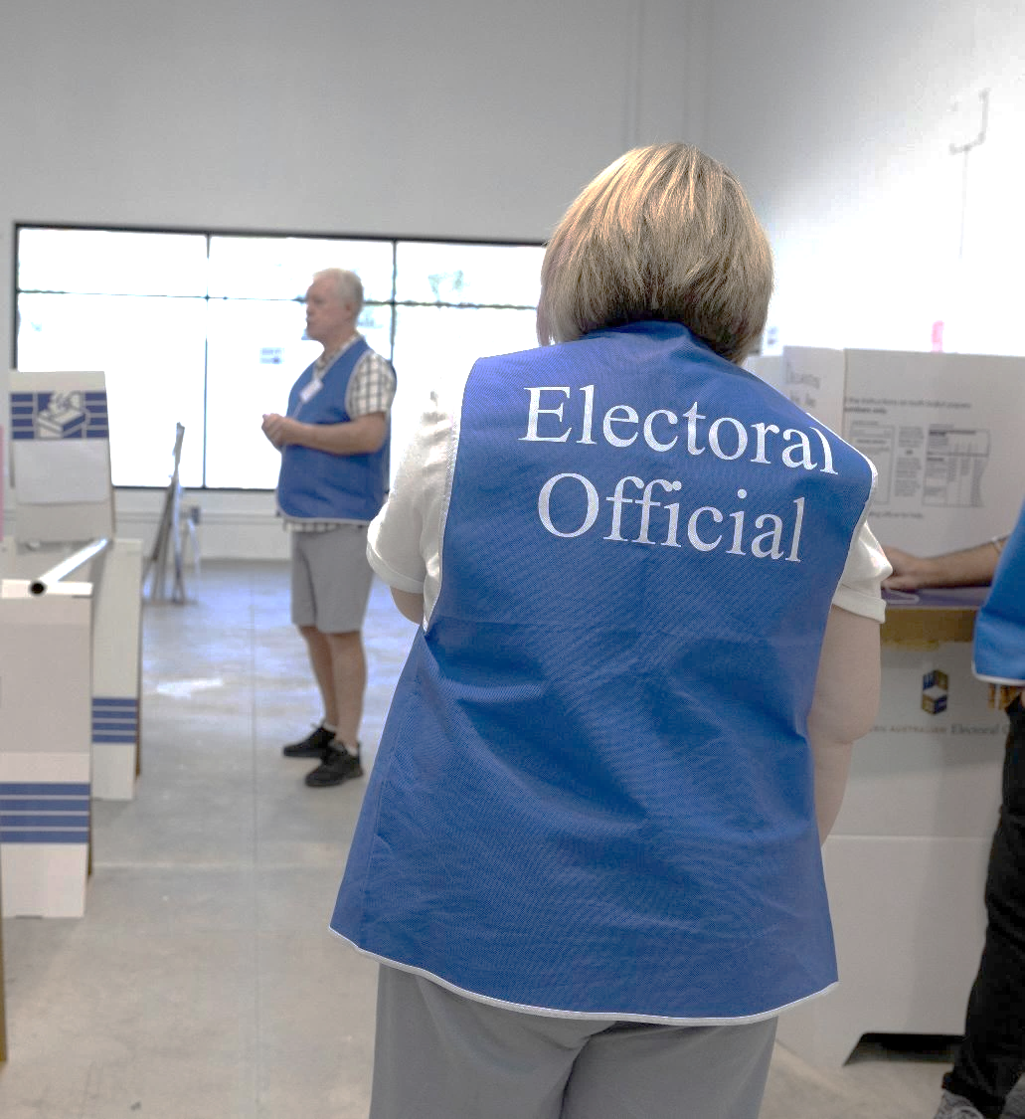
Election Day
6pm Close of Poll
  Ballot Boxes are opened and votes are counted.
  Optional preferential counting method used. (Mayoral count completed first then Councillor count)
  Scrutineers can observe the counting of votes
  The Returning Officer may declare the results on a day after election day
  Results are posted onto the Commission’s election website www.elections.wa.gov.au
Notes:
On Election day the close of Poll will be at 6.00pm
From this time, ballot boxes are opened, and the counting of votes commences.
Optional preferential voting is the voting system used which means voters don’t have to number a preference against every candidate. They can just pick one, or number some, or number all in the order or their preference.
If no candidate receives the quota of first preference votes, the candidate with the least amount of votes is excluded, and their votes go to whoever was ranked next.
If a ballot doesn’t have a next choice, it’s set aside as exhausted. This continues until candidates are elected to all vacancies.
Due to the complexity of the count, counting may continue into Sunday and may include a recount in some instances.
Scrutineers are welcome to attend and observe the process to ensure transparency and integrity.
The Returning Officer may declare the results after election day, depending on the progress of the count.
Final results will be published on both the relevant Local Government’s website and the WA Electoral Commission’s website at elections.wa.gov.au

Slide 18
Candidate essential information
Refund of deposits
Authorisation of
electoral material
Scrutineers
Disclosure of
electoral gifts
  Deposits are refunded to:
  Any candidates elected
  Any candidate who withdraws before the close of nominations
  Any non-elected candidates who receive at least 5% of the total number of first preference votes included in the count
  Handbills, pamphlets, notices, letters and other printed articles – must have NAME and ADDRESS of person authorising and the NAME and ADDRESS of printer
  The address must NOT be a post office box
  All online election material requires the NAME and ADDRESS of the person authorising the material
  Must be appointed by a candidate in writing. Scrutineer Appointment Form
  Refer to Information for Scrutineers available on the WAEC website for rights and obligations
  Chief Executive Officer maintains electoral gift register
  Gift Register is available for public viewing on the local government's official website
  Part 5A of the Local Government (Elections) Regulations 1997
Notes:
A candidate’s deposit is refunded if they are elected, or if they are not elected but receive at least 5% of the total first preference votes counted
Electoral Materials including handbills, pamphlets, notices, letters, and printed articles must include the name and physical address of the person authorising the material and the name and physical address of the printer. The addresses must not be a PO Box.
Refer to your local government local-laws regarding election signage as there may be restrictions where signs can be placed.
In regard to online election advertising material, this requires the name & address of the person authorising the advert.
Scrutineers must be appointed in writing by the candidate. Scrutineers have the right to enter and be inside a polling place at anytime before close of poll. They can be present after close of poll and observe the conduct of the election, the checking of postal voting papers and all proceedings at the count.
Only one scrutineer per candidate is permitted inside a polling place at any given time, unless they are there to vote, deliver their own ballot. They can’t assist with the conduct of the election, or record the names of individuals receiving ballot papers.
Information for Scrutineers is available on the WAEC website.
The WA Electoral Commission is not responsible for maintaining the Electoral Gifts Register. All enquiries regarding electoral gifts should be directed to the relevant local government’s Chief Executive Officer.
The CEO is responsible for maintaining the register, which must be kept up to date and made publicly available on the local government’s official website
Any disclosures are to be made to the Chief Executive Officer on the prescribed form (Form 9A).
Candidates must disclose any gift of $300 or over, or 2 or more gifts made by 1 person totalling $300 or more promised or received within the 6 month period prior to election day.
This can include: money; gifts; discounts; and provision of services.

Slide 19
Disclosure of electoral gifts
Disclosure period | Begins Group 1 - 26/09/2025 Group 2- 28/09/2025 (6 months before election day).
Gift Acceptance rule | Candidates must know the name and address of each donor before accepting a gift.
Disclosure obligations | Gifts received before nomination: disclose within 3 days of nomination. Gifts received after nomination: disclose within 3 days of receipt.
Penalties | Up to $10,000 fine for non-compliance. $500 daily penalty for late disclosures.
Disclosure period ends | Unsuccessful candidates: 3 days after election day. Successful candidates: on the start date for financial interest returns.
Gift Register | Maintained by the local government CEO. Published on the local government’s website. Must be kept for 4 years after the election.
Notes:
A candidate must not accept any electoral gift during the six-month disclosure period leading up to election day (starting 18 April 2025) unless they know the name and address of each donor.
Failure to comply may result in a fine of up to $10,000.
All gifts promised or received during this period must be disclosed to the local government CEO.
Gifts received before nomination must be disclosed within three days of nomination, and any gifts received after nomination must be disclosed within three days of receipt.
Late disclosures can incur a $10,000 fine plus a daily penalty of $500.
The disclosure period ends three days after election day for unsuccessful candidates, and on the start date for financial interest returns for successful candidates.
All disclosed gifts must be recorded in the electoral gift register, which is maintained by the local government CEO and published on the local government’s website.
The register must be kept for four years after the election.

Slide 20

  2025 Local Government Ordinary Election
  Thursday 26 March
  Saturday 28 March
Resources
March
2026
8
Notes:
The WA electoral Commission wishes all candidates nominating for Local Government elections well in their campaigns as they contribute to shaping the future of their local communities
Visit elections.wa.gov.au for more information about the Local Government Elections.

Slide 21

Thank You!

